Slide 1



Slide 2
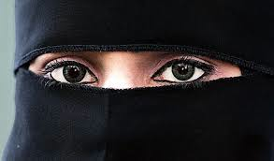

Slide 3
British Bangladeshis:
Heritage, culture, history and the complexity of identity.
Dr Aminul Hoque, Goldsmiths College, University of London
LETTA Trust staff INSET day, 3rd September 2024

Slide 4
Today’s talk….
Will offer insight, understanding, perspective into the everyday ‘lived experiences’ of British Bangladeshis
Is informed by my own lived experience as a British-Bangladeshi and as a father to 3 young daughters; my academic & professional research journey; my journalism and TV documentary media adventure; and in-depth policy work with government

Slide 5
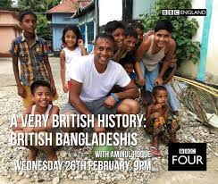
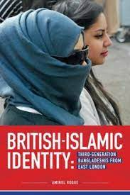
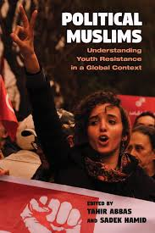
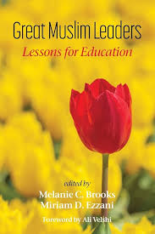
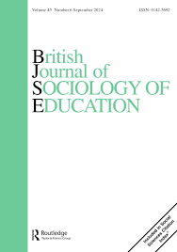

Slide 6
Structure of talk
Context and background
Discuss my research & media work
British-Bangladeshis – current situation and challenges ahead (2024)

Slide 7
Context, history & background

Slide 8

British-Bangladeshis

Slide 9
British Bangladeshis – A universal story of migration
Migration (‘push’ & ‘pull’ factors, by invitation, predominantly a gendered (male) experience)
Settlement (working class reality, exclusion, discrimination, violence, racism)
Fighting back (exercising rights, resistance, contest & protest, politics of recognition - ‘we are here to stay’, 1978 – murder of Altab Ali)
Family Re-Union (wives and children join, demand for equality, access to resources – education, health, housing, ‘halal’ food, role of language and religion important, 1981 Nationality Act)
A ‘British’ community (law-abiding, loyal, citizens, legal, tax-payers, return visits, complexity of ‘home’, intergenerational change and continuity, [652,000, 2021])

Slide 10
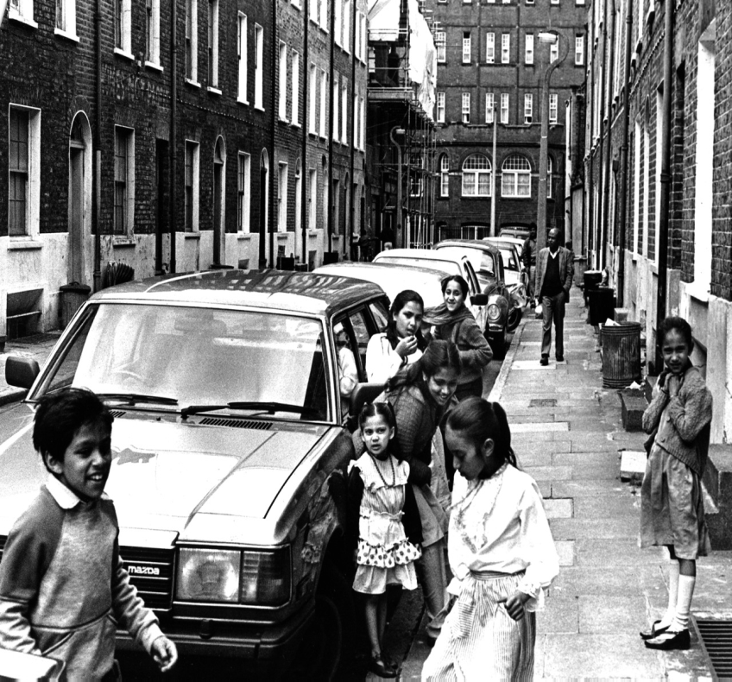
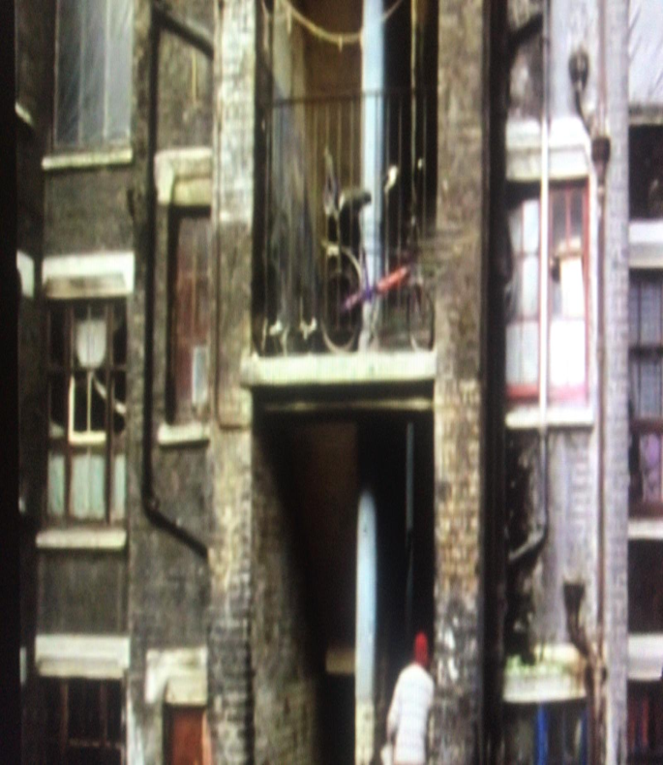
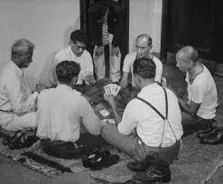
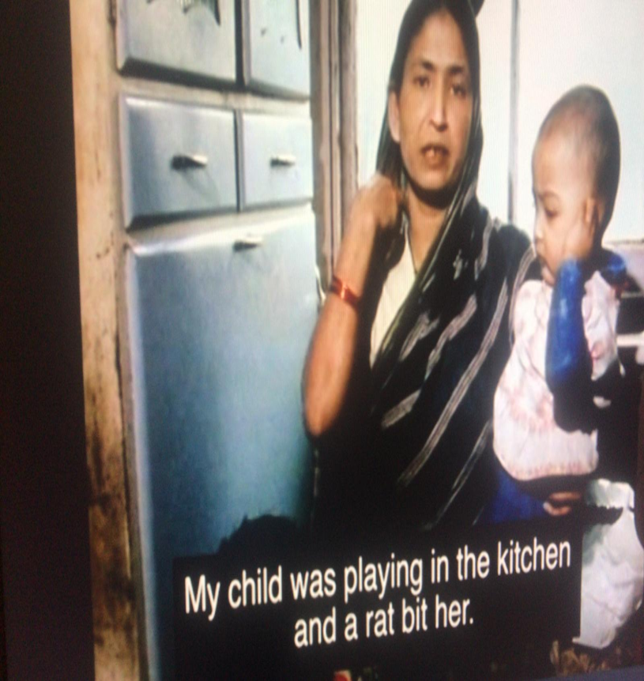
Poverty
Deprivation
Disadvantage
Inequality
Destitution

Slide 11
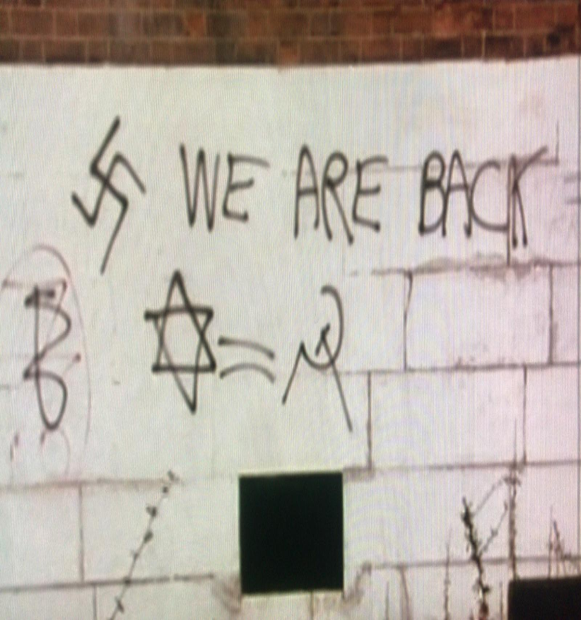
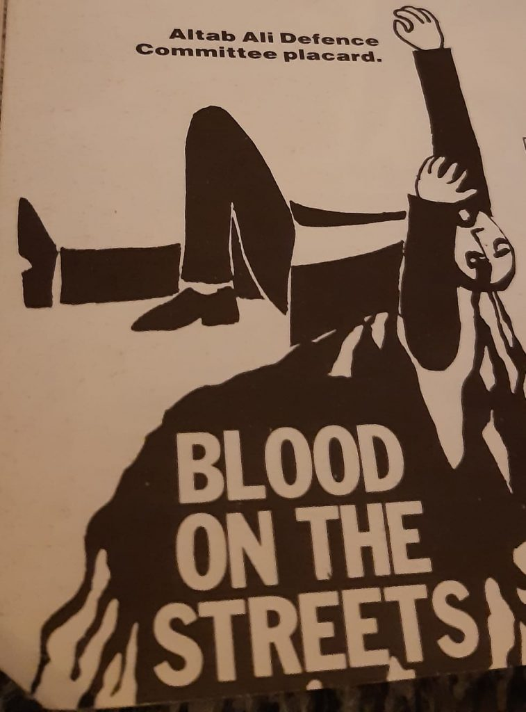
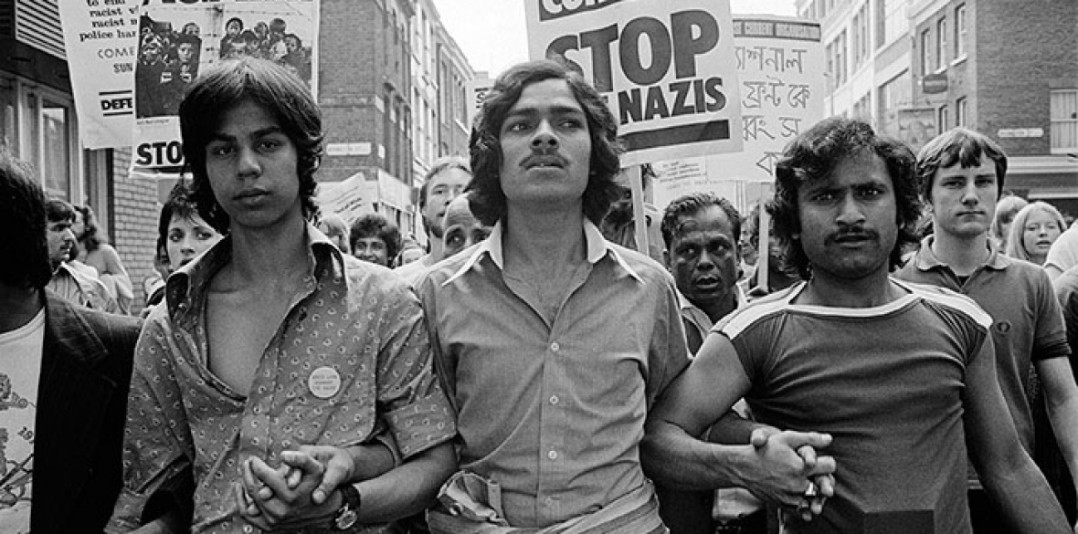
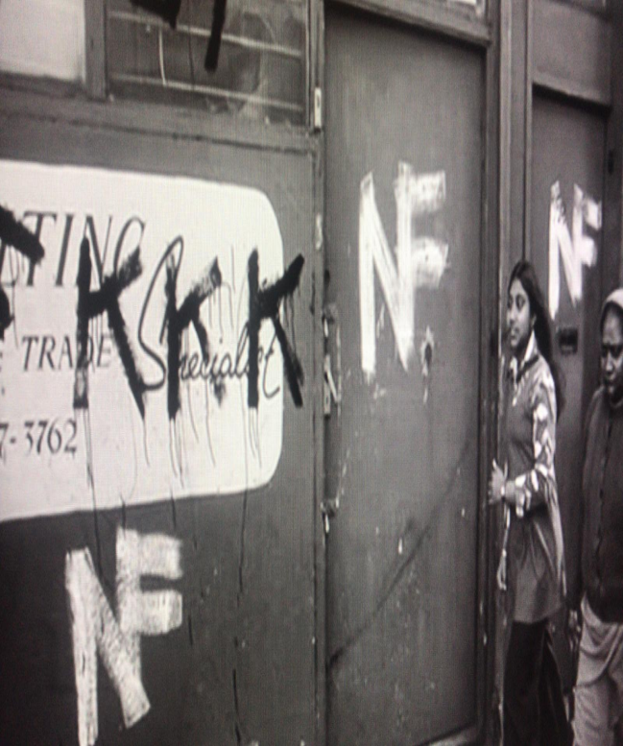
Protest
Contest
Equality
Resistance
Recognition

Slide 12
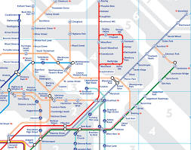
Suburban movement (since mid 1990s) – from zone 2 to 3,4,5

Slide 13
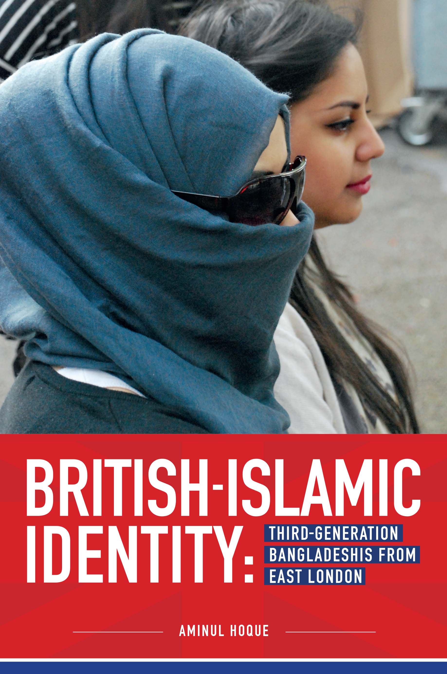
Earlier research
2004-2010 – ethnographic research focused on identities of British-born Bangladeshis from east London in community, cultural, educational settings. Involved multiple in-depth life history interviews and participant observations.
Recent research
2015-16 - Group & in-depth one-to-one interviews with young Bangladeshi Muslims of their schooling experiences, advocating a more culturally responsive pedagogy.

Slide 14
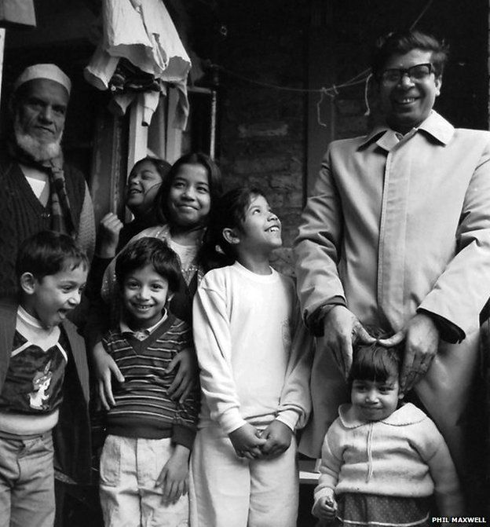
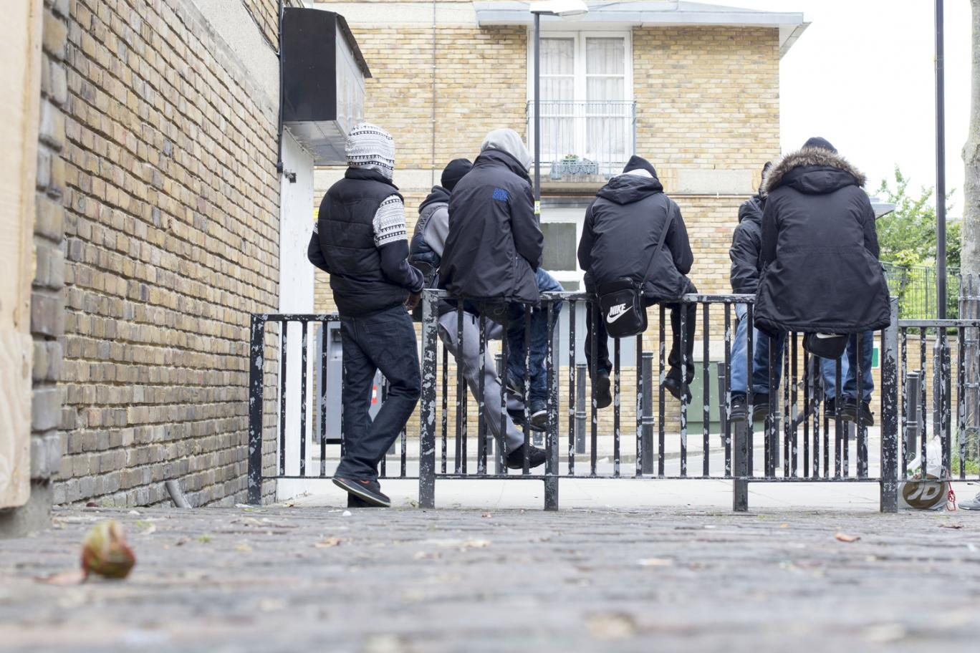
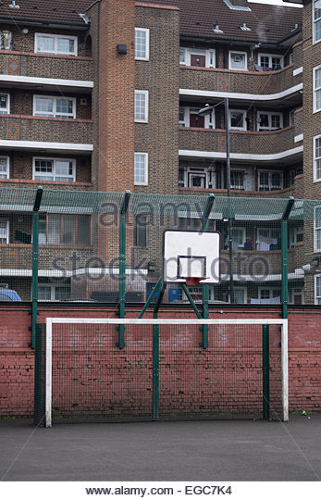

Slide 15
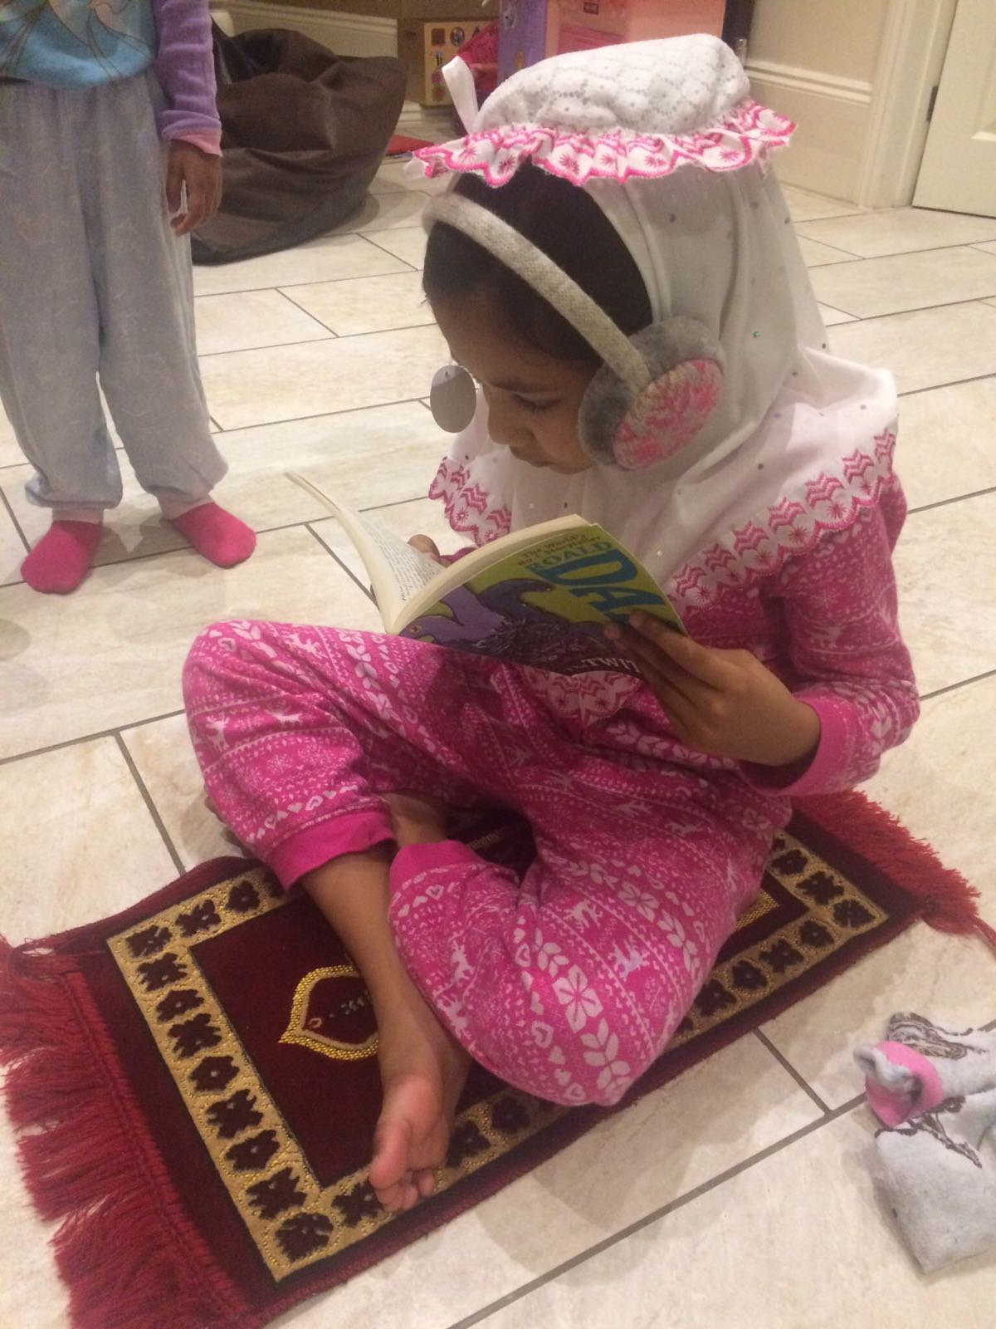

Slide 16
‘The Bengali people are so backwards and the Bengali language is useless. What is the point of speaking it? My first words were ‘mum’ and ‘dad’ and not ‘amma’ and ‘abba’. I prefer English’
(Taiba, aged 17)

Slide 17
Overlapping stories
Dislocation, alienation, exclusion, upheaval, struggle, poverty, deprivation, austerity, disengagement, disconnection from language and culture, racism, Islamophobia, the complexity of ‘home’, the question of ‘Britishness’, challenges of integration, the social role of Islam, the multiple meanings of hijab, non-belonging, questions of identity

Slide 18



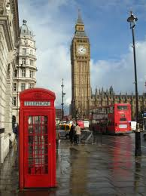
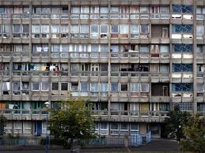
Identity crisis of ‘non-belonging’

Slide 19
A Question of Identity is situational…
Who Am I ? British, Bangladeshi or Muslim ?
“Sometimes I am a proper Muslim. Like during Ramadan when I am fasting. Sometimes I am Bengali like when I go round my aunties with my family and we have to dress up and eat lots of food. Err, and sometimes I am British when I am out with my mates going out for a meal or to the pictures” (Zeyba, aged 15)

Slide 20
The complexity of Britishness
“I have a right to be British. I was born and raised here. No one can take that right away from me” (Saeed, aged 19)
“As Bangladeshi Muslims, we are different to most British white people. But we can be different and also be British at the same time” (Taiba, aged 17)
“I cannot be British because I am not white” (Leila, aged 18)

Slide 21
Where is ‘home’ ?
“I didn’t enjoy my visit to Bangladesh. I was sick and did not enjoy the hot weather. I missed my mates in London. My family always talk of Bangladesh as ‘home’. My visit to Bangladesh made me realise that home for me was East London” (Saeed, aged 19)
“I don’t think that I would be able to adapt to the Bangladeshi way of life. Life is very different over there. The food, weather, drainage, culture, clothes, transport, electricity, and too much poverty. I know how lucky I am. I am happy that they [grandparents] came here…” (Sanjida, aged 16)
“I hate going to Bangladesh. London is my home” (Zeyba, aged 15)

Slide 22
The Complexity of ‘home’
However, ‘home’ was a complex and painful concept in that:
“No matter how much I consider myself as British, they, will never consider me as such because I have a different skin colour and a beard… it’s just the way they ‘look’ at me” (Shahin, aged 20)
“I really wanted to have white skin. I was scared. I hated being black or brown or whatever else. I wanted to be white just so I wouldn’t hear things as ‘go back to your own country, you don’t belong here’” (Sanjida, aged 16)
“we would constantly hear things as ‘go back to your own country, you don’t belong here’… where do we actually belong if we don’t belong here ?... why can’t I be white ?, I used to ask my mum. I used to scrub myself hard. I used to ask my mum to bleach me” (Taiba, aged 17)
“where is it exactly that I am supposed to go back to?” (Zeyba, aged 15)

Slide 23
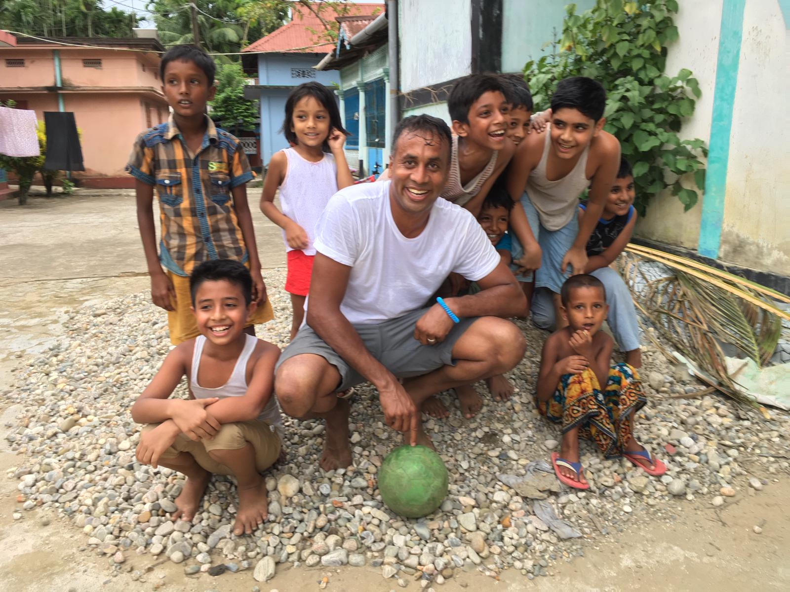
A Very British History: British Bangladeshis (2020)
BBC4, 26th Feb 2020, 9pm

Slide 24
Where is ‘home’ ?
Where is ‘home’? Is it where you are born? Where you live? Is it to do with legal definition? Where your friends and family are located? Where your childhood memories are? Where you feel comfortable and have a sense of belonging? Is it where you feel safe and accepted and where your childhood memories are situated? Can you have more than one home? Can you feel emotional and ideological attachment to a place you have never visited before? Like culture, do we also need to think of ‘home’ as something that is in ‘transit’ (Bhaba, 2004)?
Can we have ‘multiple homes’ and ‘multiple allegiances’?

Slide 25
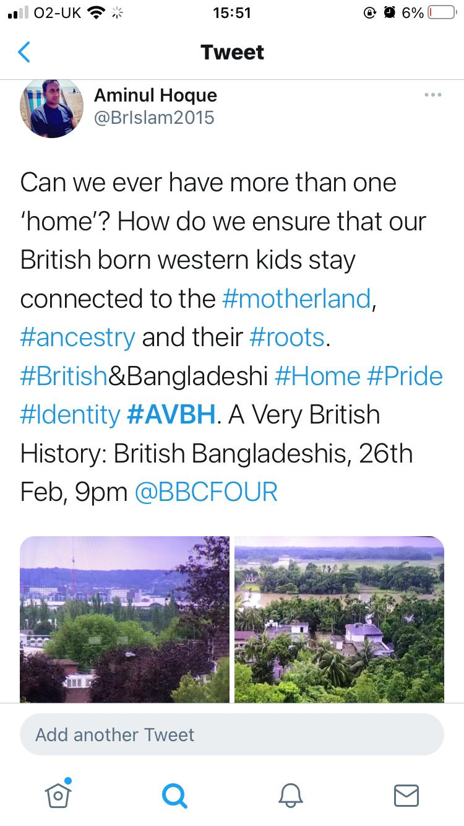
The fractured concept of ‘home’
‘I love this country. This is my home but I’m also connected spiritually to my motherland. That’s ok – to have multiple homes and multifaceted identities. It is what makes humanity so diverse and interesting’ (Hoque quoted in Cox, 2020)

Slide 26
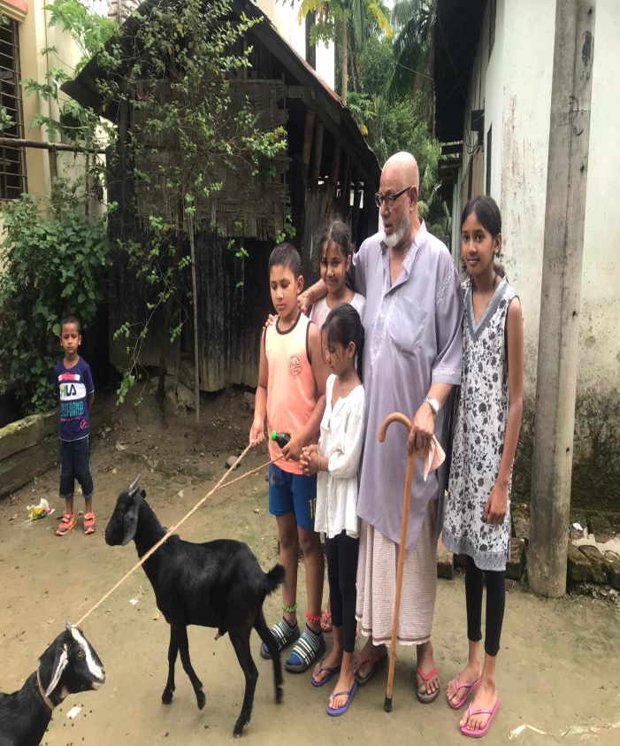
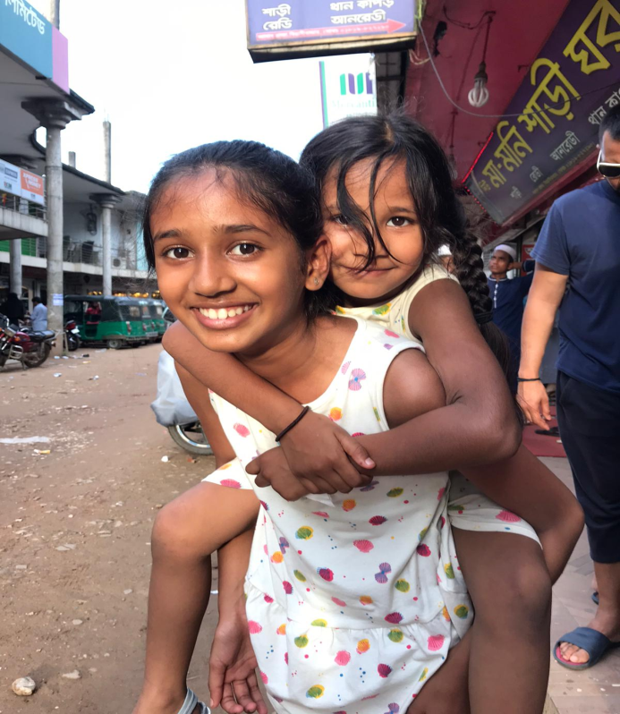
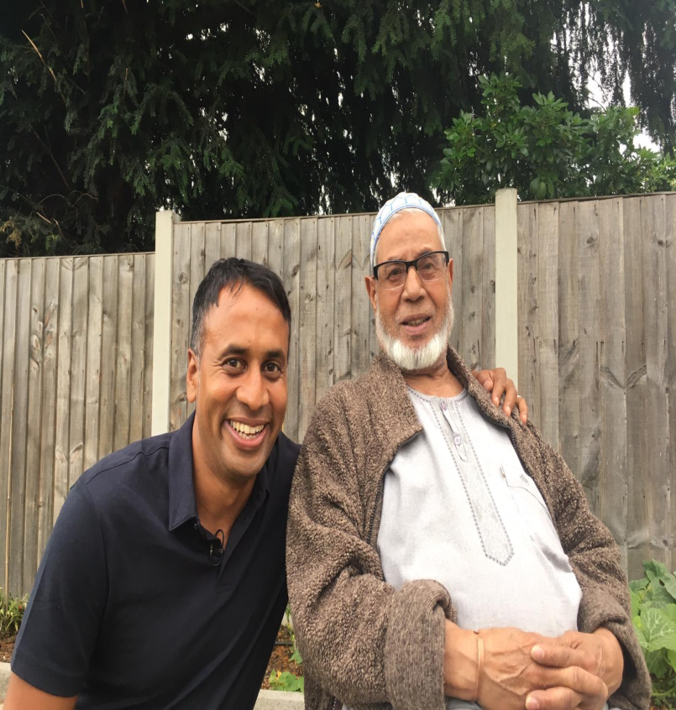
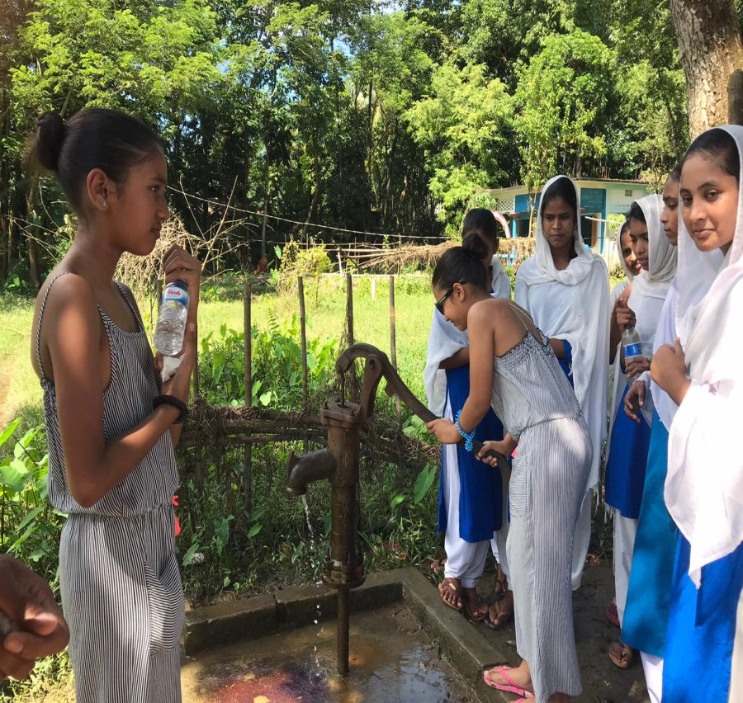
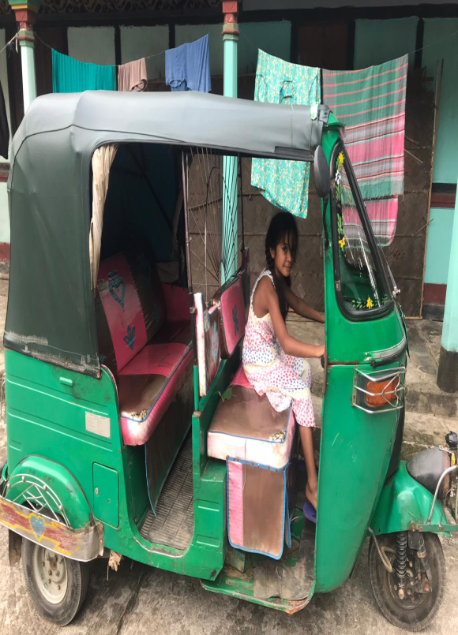
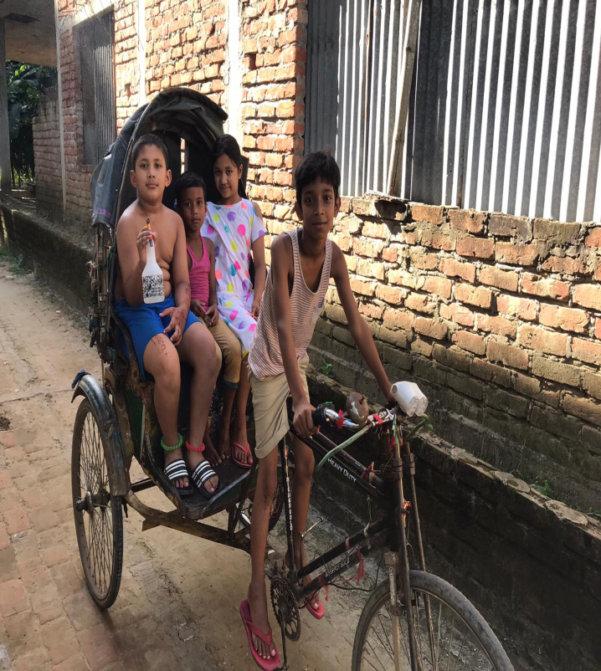
I conclude the documentary with the words: ‘My hope and aspiration is that they will continue to come – our challenge as parents is how we instil that connection with the motherland – where it began for all of us’.

Slide 27
The conundrum of non-belonging
Not being considered as being ‘British’ because of cultural, religious ‘differences’ and the colour of skin
Viewing Bangladesh as a place of ‘holiday’ and NOT ‘home’
A cultural and linguistic gap between themselves and their parents/ grandparents
Dismissed by Bangladeshis as ‘tourists’, ‘Londonis’ and ‘British’…
⬇
Where do they go?

Slide 28
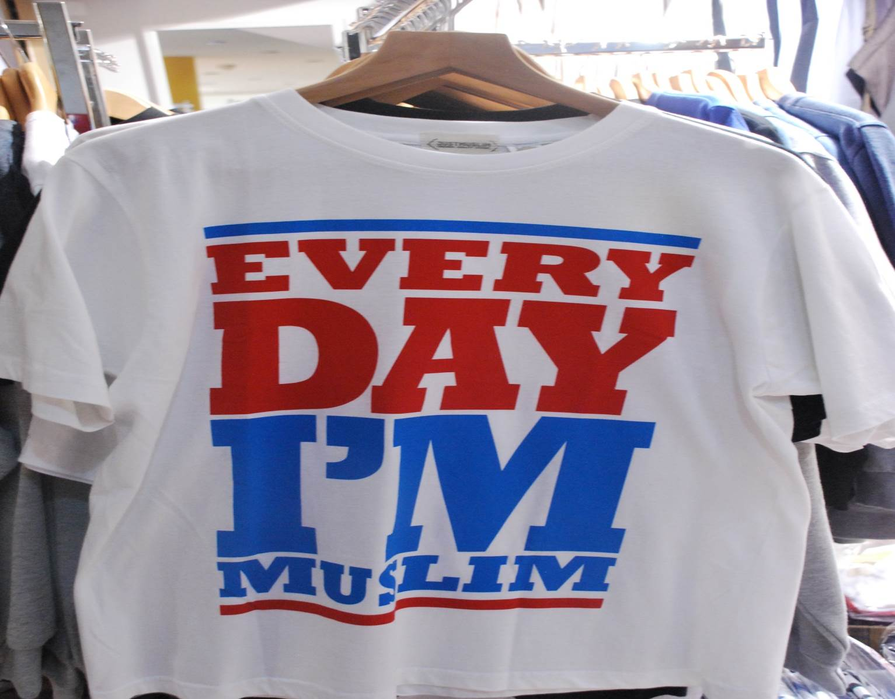
A positive/ vibrant British-Islamic identity

Slide 29
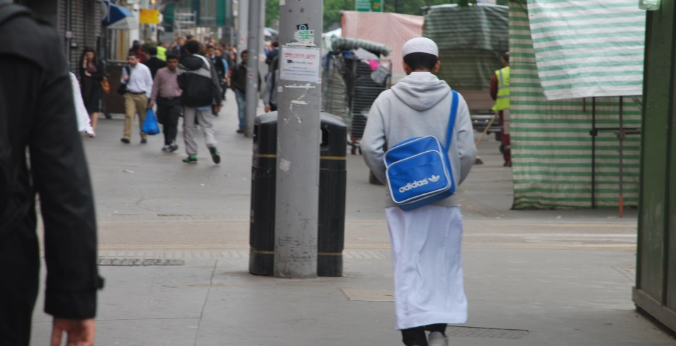
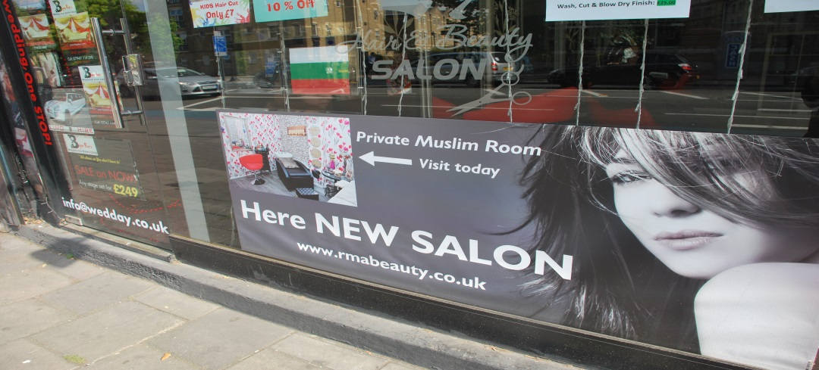
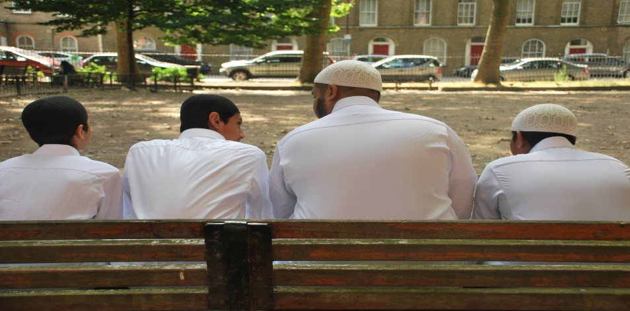
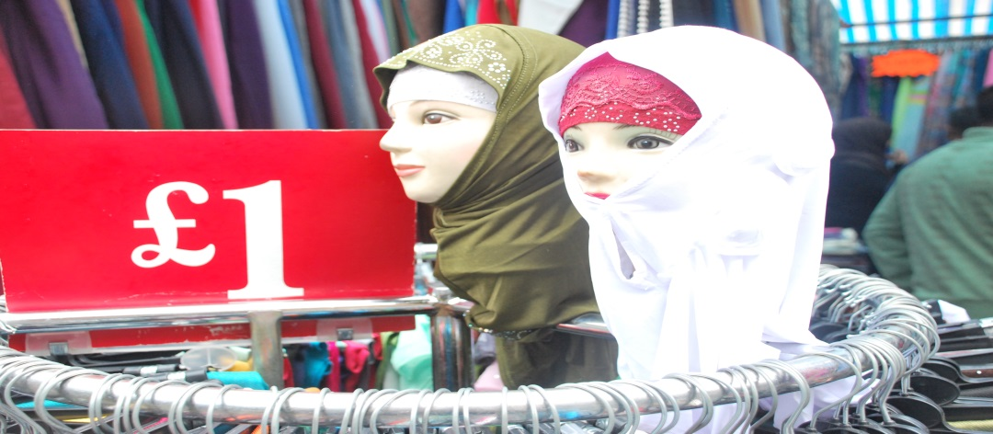
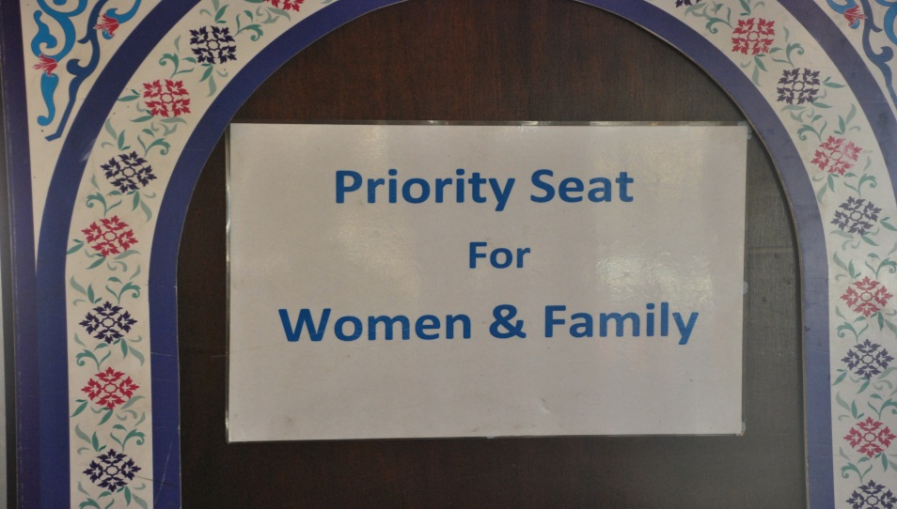
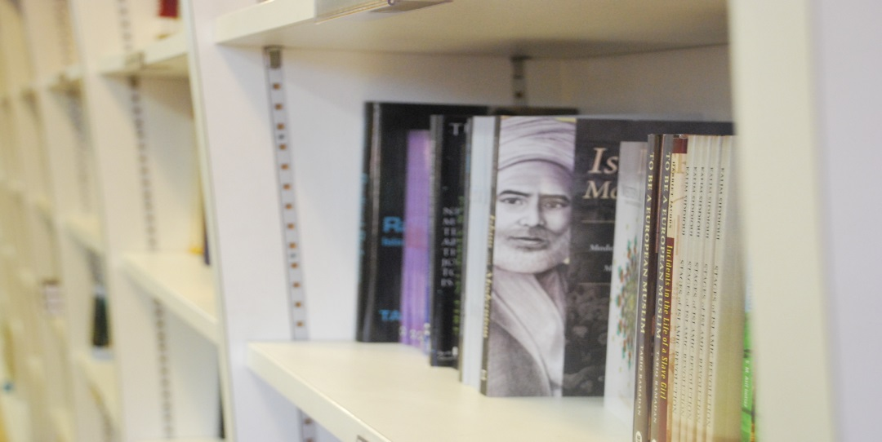
A new Islam for a new generation

Slide 30
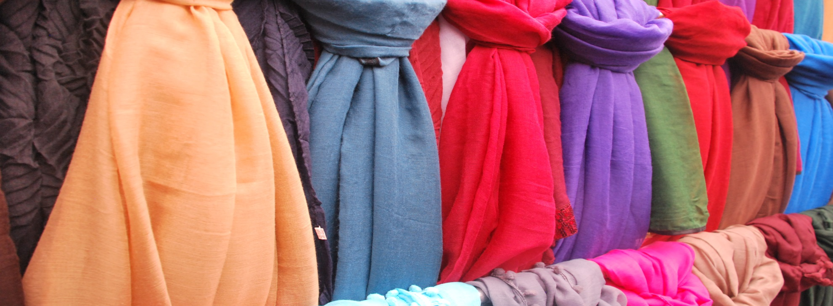
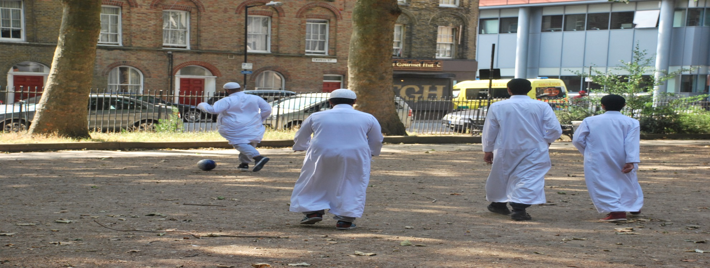

Slide 31
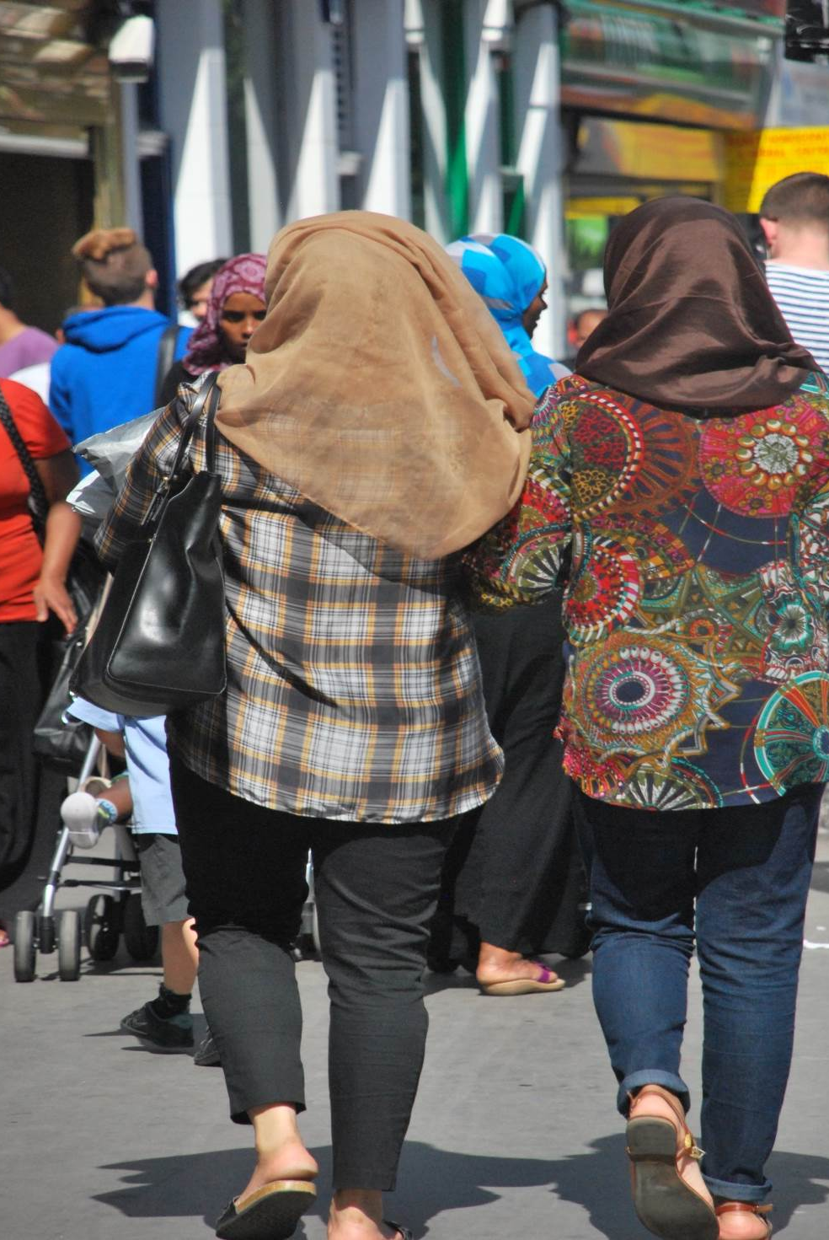
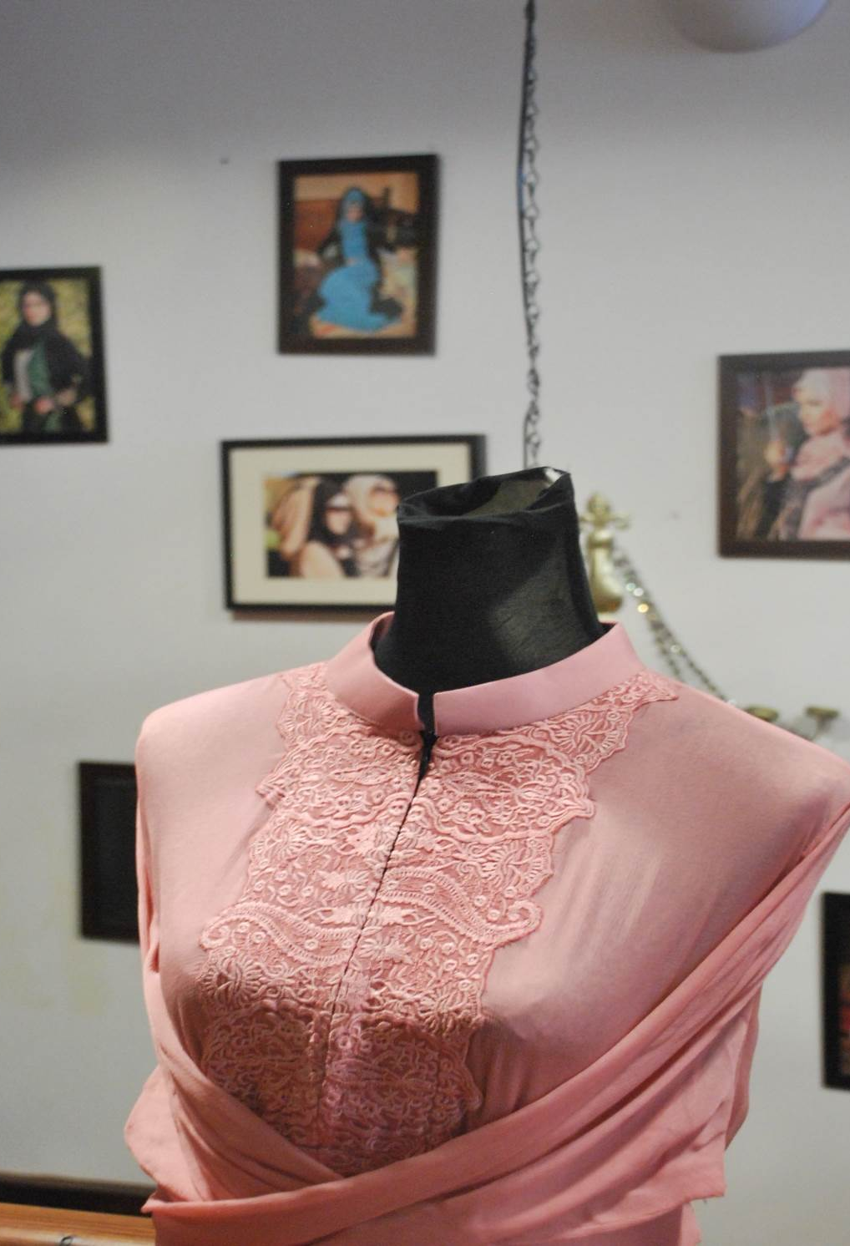

Slide 32
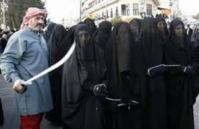
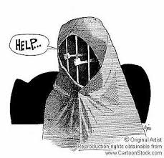
An ‘orientalist’ imagery (Said,1979)

Slide 33
How accurate is this portrayal?
“I’m not like my mother and grandmother. If I don’t agree with something then I will let others know. I am not a ‘yes’ person. I have my own mind, my own bank account and am in control of my own future” (Taiba, aged 17)
“I meet up with my girlfriends every Thursday evening and go to smoke shisha (flavoured tobacco) in Mile End. It’s a chilled place and the owners have segregated seating which means that it’s ok Islamically and we can also let our hair down and have fun without being harassed by boys for our phone numbers” (Taiba, aged 17)

Slide 34
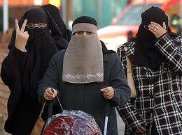
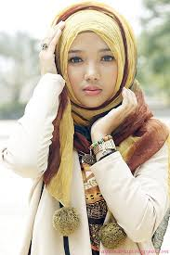
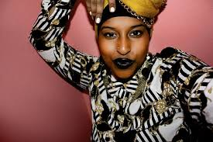
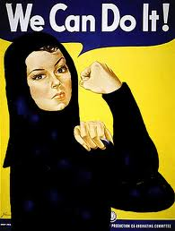
Islamic feminism?

Slide 35
2024 – challenges and opportunities

Slide 36
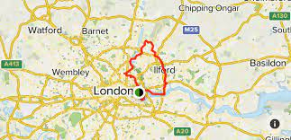
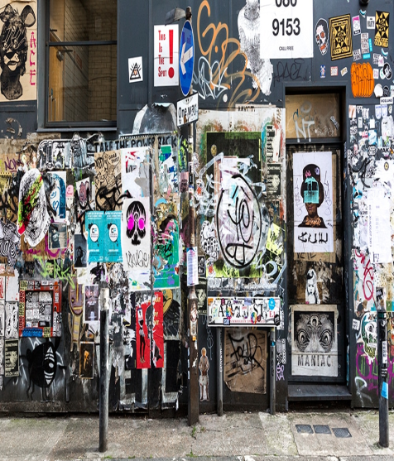
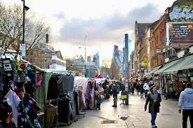



Poverty & disadvantage
Racism, Islamophobia & discrimination (recent riots 2024)
Lack of accessible role models
Intergenerational conflict (language, culture, patriarchy)
Disengaged, marginalised, alienated
Relative wealth disparity
Crime & anti-social behaviour
Young carers

Slide 37
British-Bangladeshis 2024: A sociology
The question of identity (subjective/ multifaceted) lingers…
The claim to ‘Britishness’ is real – fluid/ complex/ subjective/ exclusive/ difficult to grasp and define
Inter-generational disparity/ conflict (culture, language, technology, ideology)
Patriarchy is ‘real’ – educated and confident generation of women pushing the boundaries
Working-class reality (overcrowding - housing, health disparities, unemployment, service sector/ retail low paid jobs, crime)
Racism as a ‘lived experience’ – ‘new’ cultural racisms of ‘difference’, Islamophobia
Diversity among British-Bangladeshis (geography, social class, caste, urban/ rural, education, profession, ‘new’ European migrants)
Lack of representation in arts, media, sports

Slide 38
The debate continues…
a.hoque@gold.ac.uk
@BrIslam2015
#WhoAmI?
#WhereDoWeBelong?
#PingPongGeneration

Slide 39
References
Al-Ali, N. and K. Koser (2002) ‘Transnationalism, International Migration and Home’, in N. Al-Ali and K. Koser (eds) New Approaches to Migration? Transnational Communities and the Transformation of Home, pp. 1–14. London & New York: Routledge
Bhaba, H.K (2004) The Location of Culture, London: Routledge
Cox, S (2020) ‘Telling the ‘hidden’ histories of British-Bangladeshis’, 25th Feb 2020, https://www.gold.ac.uk/news/a-very-british-history/
Gardner, K (1993) ‘Desh-Bidesh: Sylheti images of home and away’, Man: The Journal of the Royal Anthropological Institute, 28(1):1-17
Gardner, K (2002) Age, Narrative and Migration: The life course and life histories of Bengali elders in London, Oxford: Berg.
Hall, S (1990) ‘Cultural Identity and Diaspora’, in J. Rutherford (ed.) Identity: Community, Culture, Difference, pp. 222–37. London: Lawrence & Wishart
Hall, S (1996) ‘Who needs “identity”?’, in Hall, S and du Gay, P (eds) Questions of Cultural Identity, London: Sage
Hoque, A (2015) British-Islamic Identity: Third Generation Bangladeshis from East London, London: IOE Press, Trentham Books.
Hoque, A (2018) ‘Third-generation British-Bangladeshis from east London: Complex identities and a culturally responsive pedagogy’, British Journal of the Sociology of Education, 39 (2018): 182-196
Hoque, A & Keelan, A (2020) A Very British History: British Bangladeshis, BBC4, 26th Feb
Kearney, C (2003) The Monkey’s Mask: Identity, memory, narrative and voice, Stoke-on-Trent: Trentham Books.
Kershen, A (eds, 1998) A Question of Identity, Aldershot: Ashgate.
Lawler, S (2013) Identity: Sociological perspectives, 2nd ed, Cambridge: Polity Press.
Maalouf, A (2000) On Identity, London: Harville Press
Massey, D (1994) Space, Place and Gender, Cambridge: Polity Press
Omaar, R (2007) Only Half of Me: British and Muslim – the conflict within, London: Penguin
Paritus, V (2011) ‘Home” for Now or “Home” for Good? East European Migrants’ Experiences of Accommodation in London’, Home Cultures, 8(3): 265-296
Pratt, M. B (1984) ‘Identity: Skin Blood Heart’, in E. Bulkin, M. B. Pratt and B. Smith (eds) Yours in Struggle: Three Feminist Perspectives on Anti-Semitism and Racism, pp. 10–63. New York: Long Haul Press
Said, E (1979) Orientalism, 2nd ed, Harmondsworth: Penguin.

