Slide 1
Opportunities and Risks of using social media data to intervene and prevent youth violence Dr. Akshi Kumar Akshi.Kumar@gold.ac.uk
Contextual Background
Opportunities of Using Social Media Analytics
Risks and Ethical Considerations
Questions for Discussion

Slide 2
Contextual Background
Dr. Akshi Kumar

Slide 3
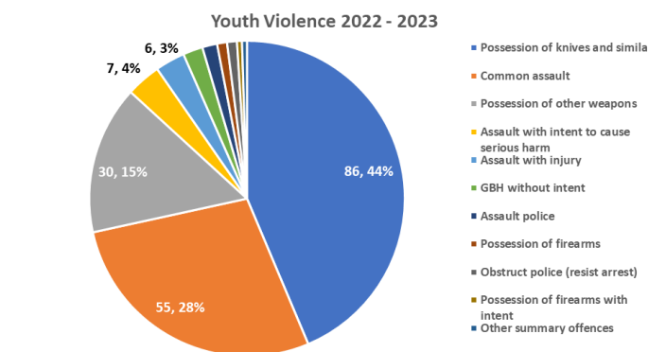
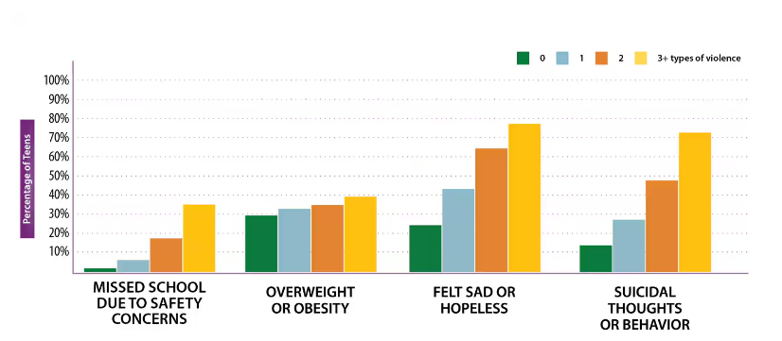
Scope and Impact of Youth Violence
Youth violence encompasses a range of harmful behaviors among individuals aged 10-24, including bullying, physical fights, and severe assaults that can lead to injury or death.
Emotional Impact: Leads to long-term trauma and fear within communities.
Economic Costs: Incurs significant healthcare, law enforcement, and community welfare expenses.
Educational Disruption: Affects school attendance and performance, influencing both victims and perpetrators.
Image Source: Croydon Youth Safety Plan 2023-26
Image Source: Violence Impacts Teen’s Lives, www.cdc.gov
Dr. Akshi Kumar

Slide 4
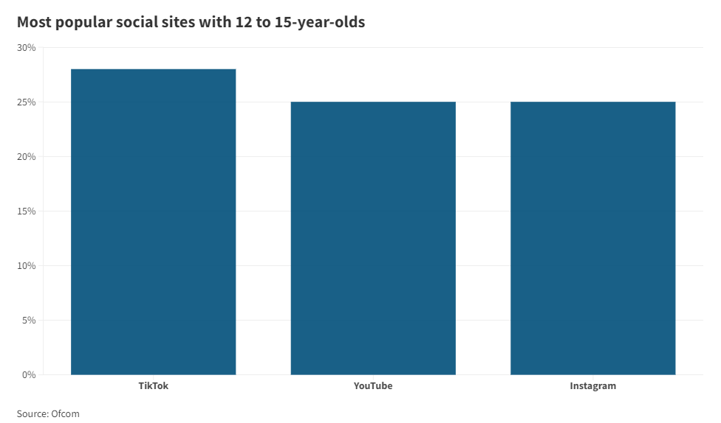
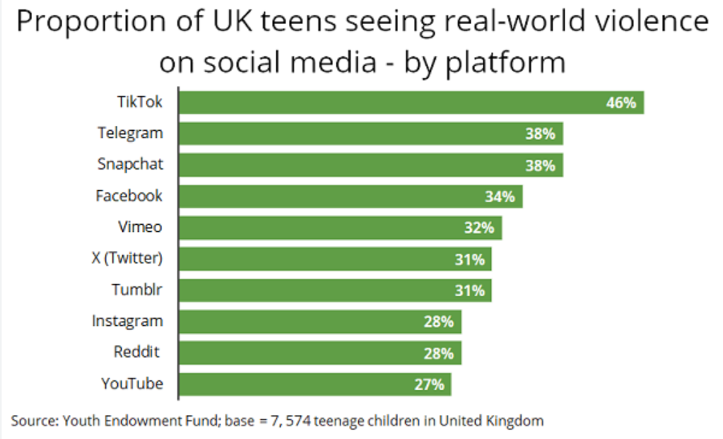
Relevance and Ubiquity of Social Media Among Youth
Approximately 95% of teens have access to a smartphone, with nearly 90% actively using social media platforms like Instagram, Snapchat, and TikTok.
Primary Communication Channels: Social media is a central hub for peer interactions and expression among youth.
Influence on Behavior: Platforms significantly influence youth behaviors and societal norms.
Image Source: Ofcom
Image Source: https://www.mediapost.com/publications/article/391013/most-uk-teens-have-seen-real-violence-on-social-me.html
Dr. Akshi Kumar

Slide 5
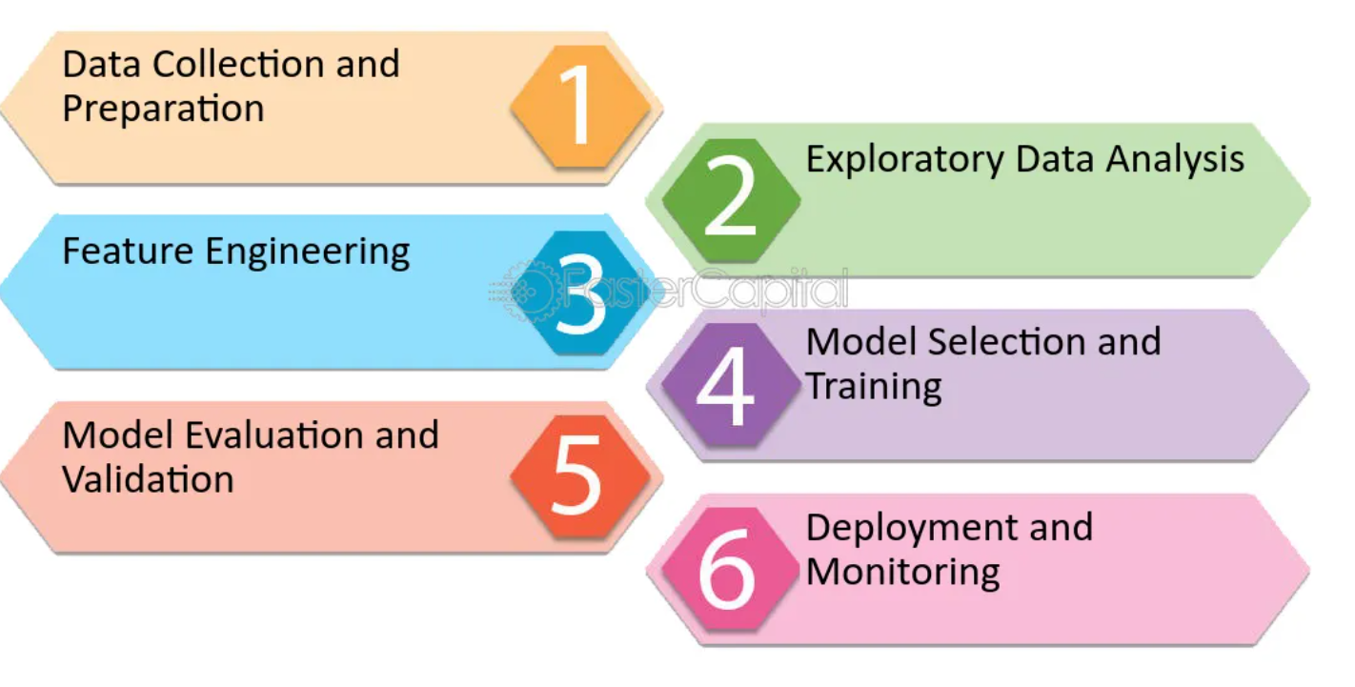
Social Media Analytics
Social media analytics involves collecting and analyzing data from social media platforms to identify trends, patterns, and behaviours.
Tools and Techniques: Incorporates advanced techniques like natural language processing and sentiment analysis to interpret online interactions.
Application to Youth Violence:
Enables monitoring of communication patterns that may predict harmful behaviours, offering opportunities for early intervention.
Image Source: Faster Capital
Dr. Akshi Kumar

Slide 6
Opportunities of Using Social Media Analytics
Dr. Akshi Kumar

Slide 7
Early Detection of Violent Behaviours
Social media analytics enable the early detection of potential violent behaviours or distress among youth by monitoring digital footprints.
Language Changes: Analyzing shifts in tone, language, and frequency of posts that may indicate aggression or distress. For example:
Increased Use of Negative or Aggressive Language: Analytics might flag a teen's posts if they suddenly start using more profanity or aggressive language than usual, indicating potential anger or distress.
Shifts from Positive to Negative Sentiments: Tools that assess sentiment analysis might notice a shift from generally positive or neutral posts to predominantly negative ones, which can signal emotional changes.
Dr. Akshi Kumar

Slide 8
Early Detection of Violent Behaviours
Interaction Patterns: Observing changes in how youths interact with peers, such as increasing isolation or aggression towards others. For example:
Reduction in Positive Interactions: If a normally sociable young person starts to receive or initiate fewer likes, comments, or shares, it might suggest feelings of isolation or withdrawal.
Increased Conflictual Interactions: An increase in arguments or hostile exchanges in comment sections of a youth’s posts could be a sign of growing frustration or aggression.
Posting Patterns: Identifying unusual posting times or rapid increases in activity that could signal underlying issues. For example:
Nighttime Posting: An increase in social media activity during late-night hours might indicate insomnia or anxiety, which are often associated with stress or depression.
Rapid Succession of Posts: If a young person begins posting very frequently or erratically, it might indicate impulsivity or emotional distress, which can be a precursor to more serious issues.
Dr. Akshi Kumar

Slide 9
Intervention Strategies Based on Analytics
Data-driven insights allow for the development of targeted intervention strategies to prevent violent outcomes effectively.
Customized Outreach Programs: Schools and local authorities can deploy customized programs based on identified risk patterns.
Tailored Educational Sessions
Targeted Counseling Services
Community Involvement Programs
Early Support Initiatives: Implementing support measures for at-risk youth before issues escalate.
Proactive Monitoring
Early Intervention Teams
Dr. Akshi Kumar

Slide 10
Enhancing Community Engagement
Social media platforms can strengthen community ties and create supportive networks, crucial in violence prevention.
Peer Monitoring: Encouraging peer monitoring to foster a supportive online community environment.
Support Groups: Facilitating online support groups that provide a safe space for expression and counseling.
Image Source: https://www.beataddiction.com/peer-support-history-importance-and-forms/
Dr. Akshi Kumar

Slide 11
Risks and Ethical Considerations
Dr. Akshi Kumar

Slide 12
Privacy Concerns
Utilizing social media analytics raises significant privacy concerns, particularly regarding the monitoring of individuals without explicit consent.
Intrusive Monitoring: Potential for perceived or actual intrusive surveillance, impacting user trust and comfort.
Data Security: Risks associated with data breaches and unauthorized access to sensitive personal information.
Consent Issues: Challenges in obtaining genuine consent from youth, complicating the ethical landscape.
Dr. Akshi Kumar

Slide 13
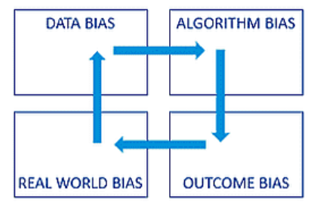
Misinterpretations and Bias
Analytical tools are not free from biases, which can lead to misinterpretations and affect the accuracy of interventions.
Algorithmic Bias: Risk of embedding existing societal biases into algorithms, potentially targeting or misidentifying specific groups.
A predictive policing tool might disproportionately flag minority youth as potential offenders due to training on arrest records that reflect historical racial biases in law enforcement practices.
Consequences of Errors: False positives (unnecessary intervention) and false negatives (missed interventions).
A social media monitoring system designed to prevent school violence might interpret a student's joking comment about "destroying" opponents in a video game as a genuine threat (false positive), leading to an unnecessary suspension. Conversely, the same system might miss a cryptic message subtly indicating plans for a real fight (false negative), resulting in a missed opportunity to intervene before the situation escalates at school.
Image Source: Vedangvats.com
Dr. Akshi Kumar

Slide 14
Dependence on Technology
Over-reliance on technology can lead to neglect of underlying social, economic, and cultural factors that contribute to youth violence.
Technological Determinism: The risk of assuming technology alone can solve complex social issues.
Ignoring Root Causes: Highlight the importance of integrating technological solutions with broader social and economic policies.
Image Source: Striking a Balance: The Role of AI and ML in Shaping Tomorrow's Cybersecurity Landscape
Dr. Akshi Kumar

Slide 15
Questions for Discussion
Dr. Akshi Kumar

Slide 16
As we consider the potential of social media analytics in preventing youth violence, I invite you to engage with these critical questions:
1. Data Accuracy: "How reliable is the data collected from social media, and what are the implications for research and intervention?"
2. Ethical Frameworks: "What ethical frameworks are currently in place, and what should be implemented to safeguard privacy and ensure fairness?"
3. Case Studies: "Are there any successful case studies or pilots that have effectively used social media analytics for youth violence prevention? What can we learn from them?"
4. Future Directions: "How do you see the role of social media analytics evolving over the next 5-10 years in the context of youth violence prevention?"
Dr. Akshi Kumar

Slide 17
Thank You
Dr. Akshi Kumar

